Slide 1
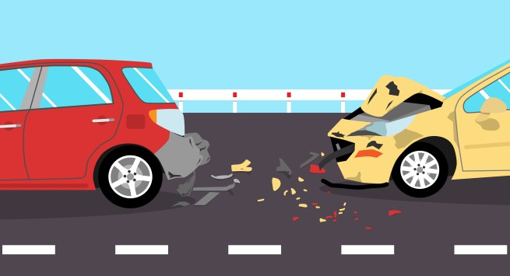

Car Accidents
Lior turgeman 304941412
Dan avERIN 204358394

Slide 2

Project Overview and Research Question
Is there a connection between the amount of car accidents to the weather conditions occurred at the time of the accident?
Is there a connection between the weather and the type of accidents happened (In intersection, what type of Objects were harmful in the collision…)
Is there a connection between car accidents and the time/day/night conditions?
In which states more car accidents are likely to occur?

Slide 3
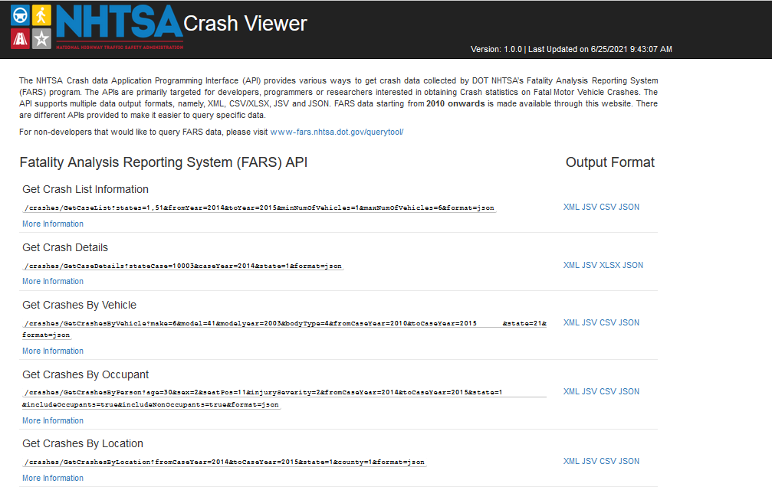
API & Sources
We chose to use information from NHTSA(National Highway Traffic Safety Administration) - agency of the U.S. federal government, part of the Department of Transportation.
https://crashviewer.nhtsa.dot.gov/CrashAPI
We used the API to retrieve CSV data files from years 2010 up to 2019.

Slide 4
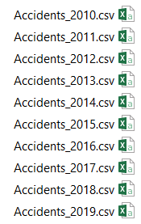
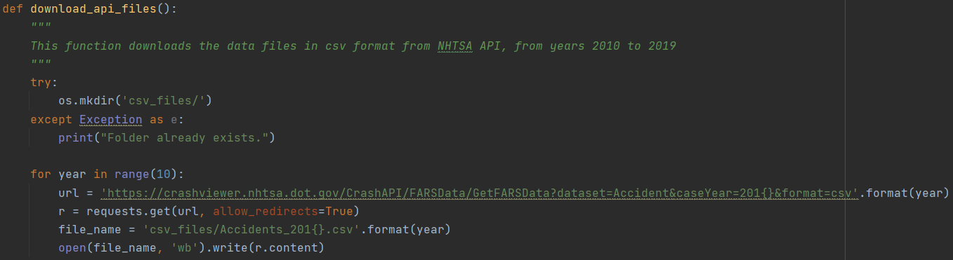
API & Sources
The following NHTSA API - https://crashviewer.nhtsa.dot.gov/CrashAPI
There is a lot of API options, and we chose to Get FARS Data By Year with the richest variety of information.
The data pulled using the following API requests:
https://crashviewer.nhtsa.dot.gov/CrashAPI/FARSData/GetFARSData?dataset=Accident&caseYear=X&format=csv
X – represents every year from 2010 up to 2019
We combined and created new big CSV File with all the data combined.

Slide 5
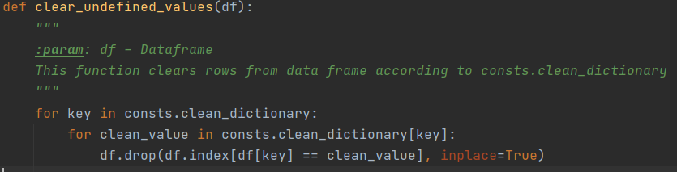
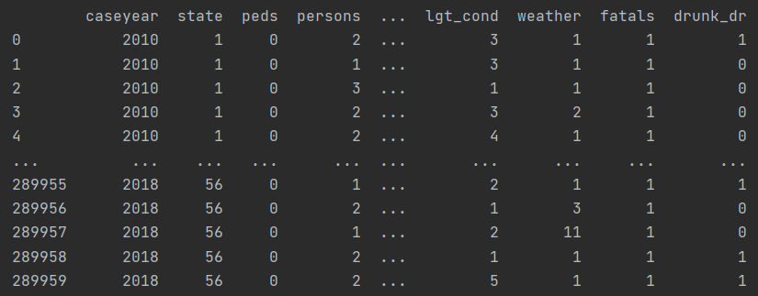
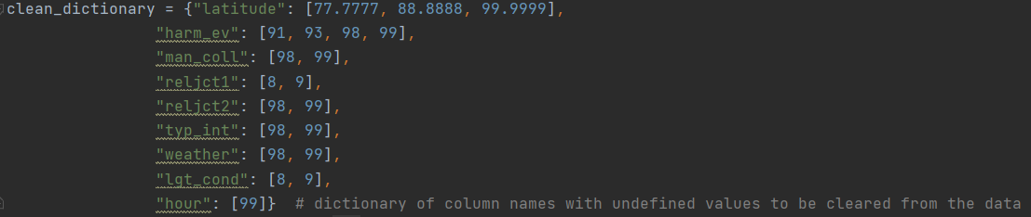
Data Handling and Cleaning
- In our project we used data from the years 2010 up to 2019.
- Each year had close to 35,000 records, eventually we got 323,480 records as result of 10 years of car accidents data from the USA.
- We omitted irrelevant data from the original csv files, combined all data to one file which will be used to research the question we presented.

Slide 6
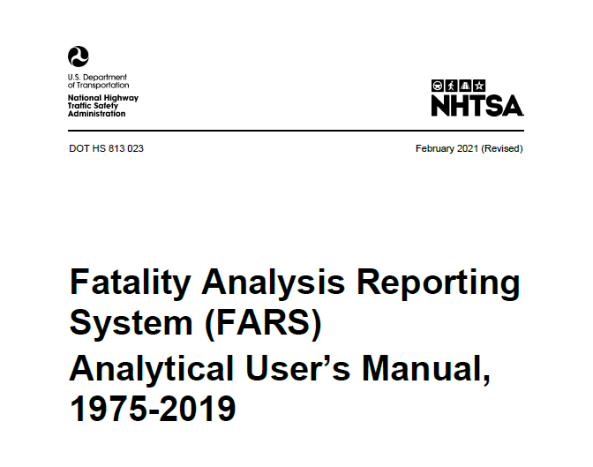
EDA
As we checked our data, we cleared irrelevant information regarding our research questions.
FARS provides PDF File with information regarding each column, under the filename:
“Fatality Analysis Reporting System (FARS) Analytical User’s Manual,
1975-2019.PDF”
The file is attached in the project under documents folder.
We defined a List with all irrelevant columns to be removed from The CSV data files, According to the PDF file.

Slide 7
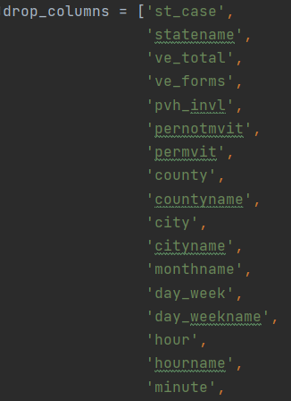
EDA
Almost any column appears twice, first column as text, and secondly as Nominal number.
For getting more reliable data we cleared from every column unknown values, and columns that irrelevant data for our research question
For example:
Reason omitted | PDF Column explanation
File consecutive number
Our research question does not refers to forms.

Slide 8
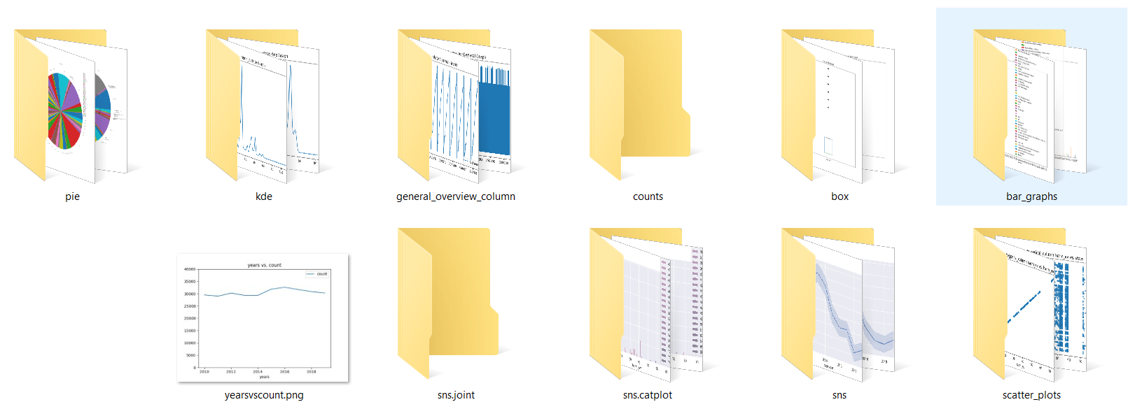
Graphs
We Used Pandas, Seaborn, Matplotlib to generate different variety of graphs according to our data.

Slide 9
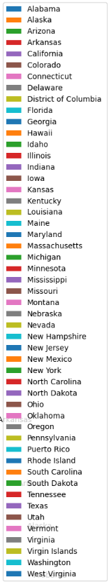
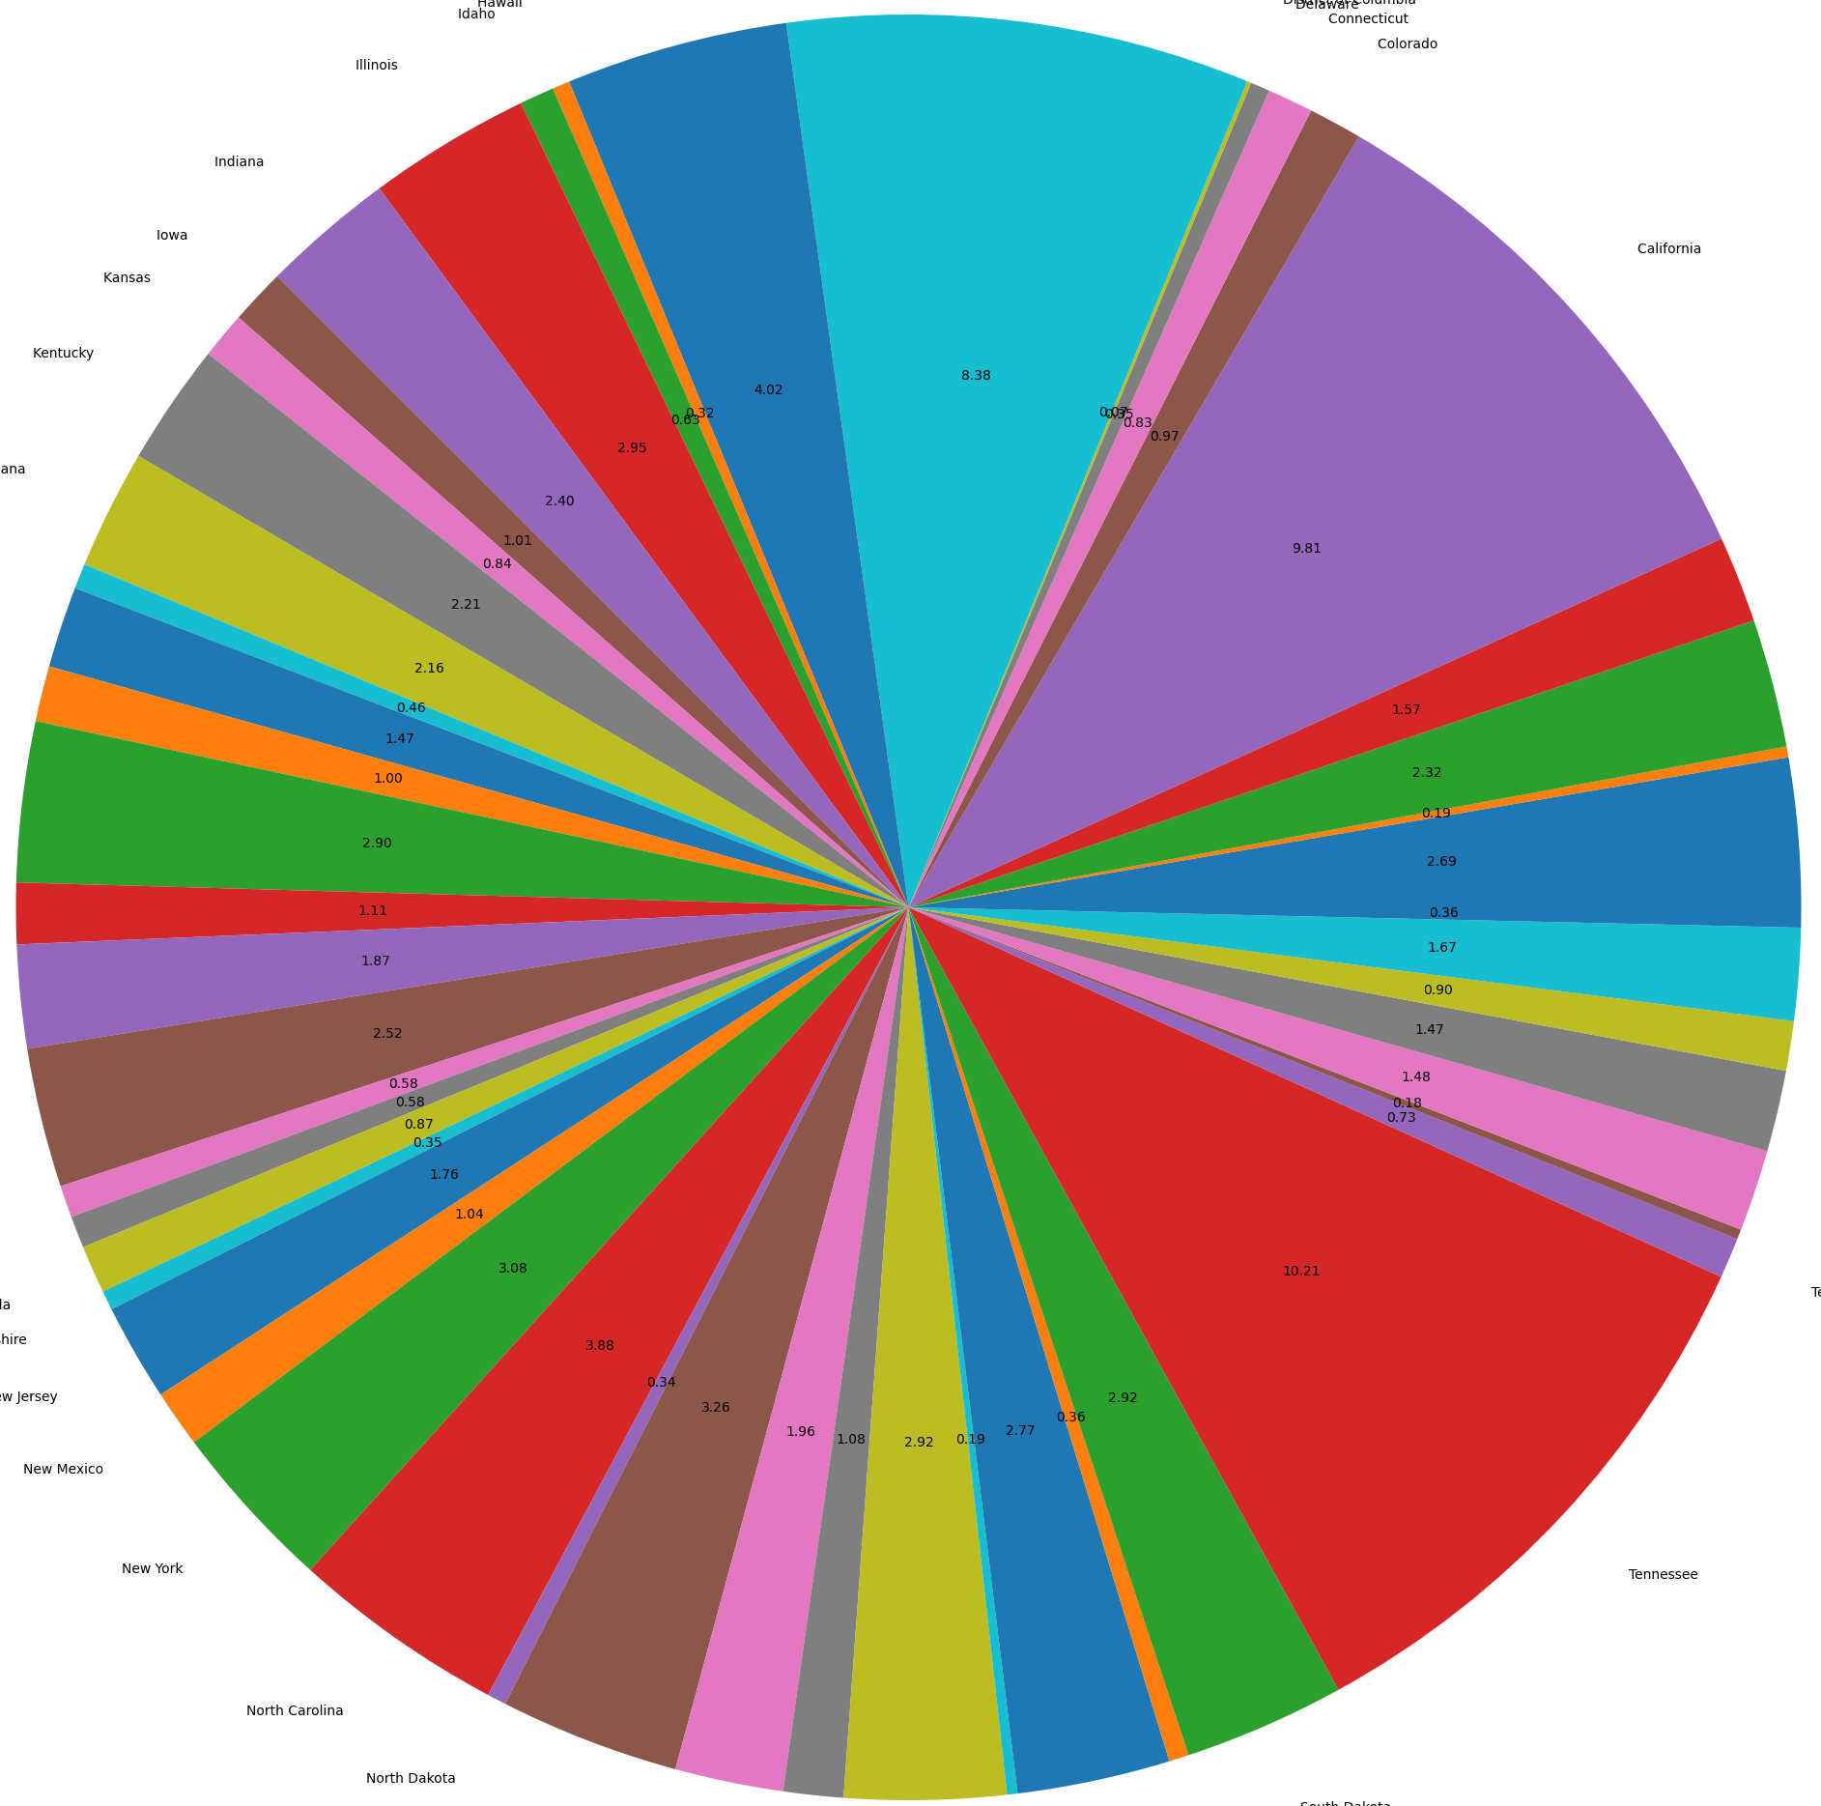
Graphs
Amount of Accidents Per State:
We can see that the most common states with accidents is Tennessee and the Florida.

Slide 10
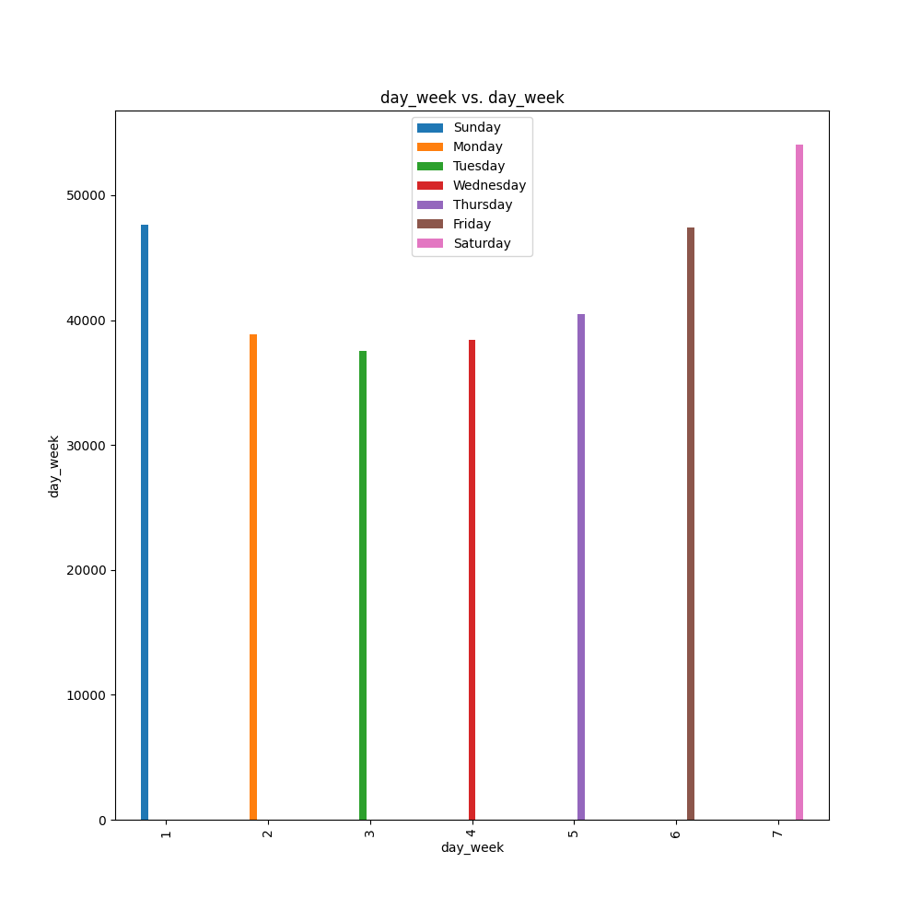
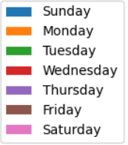
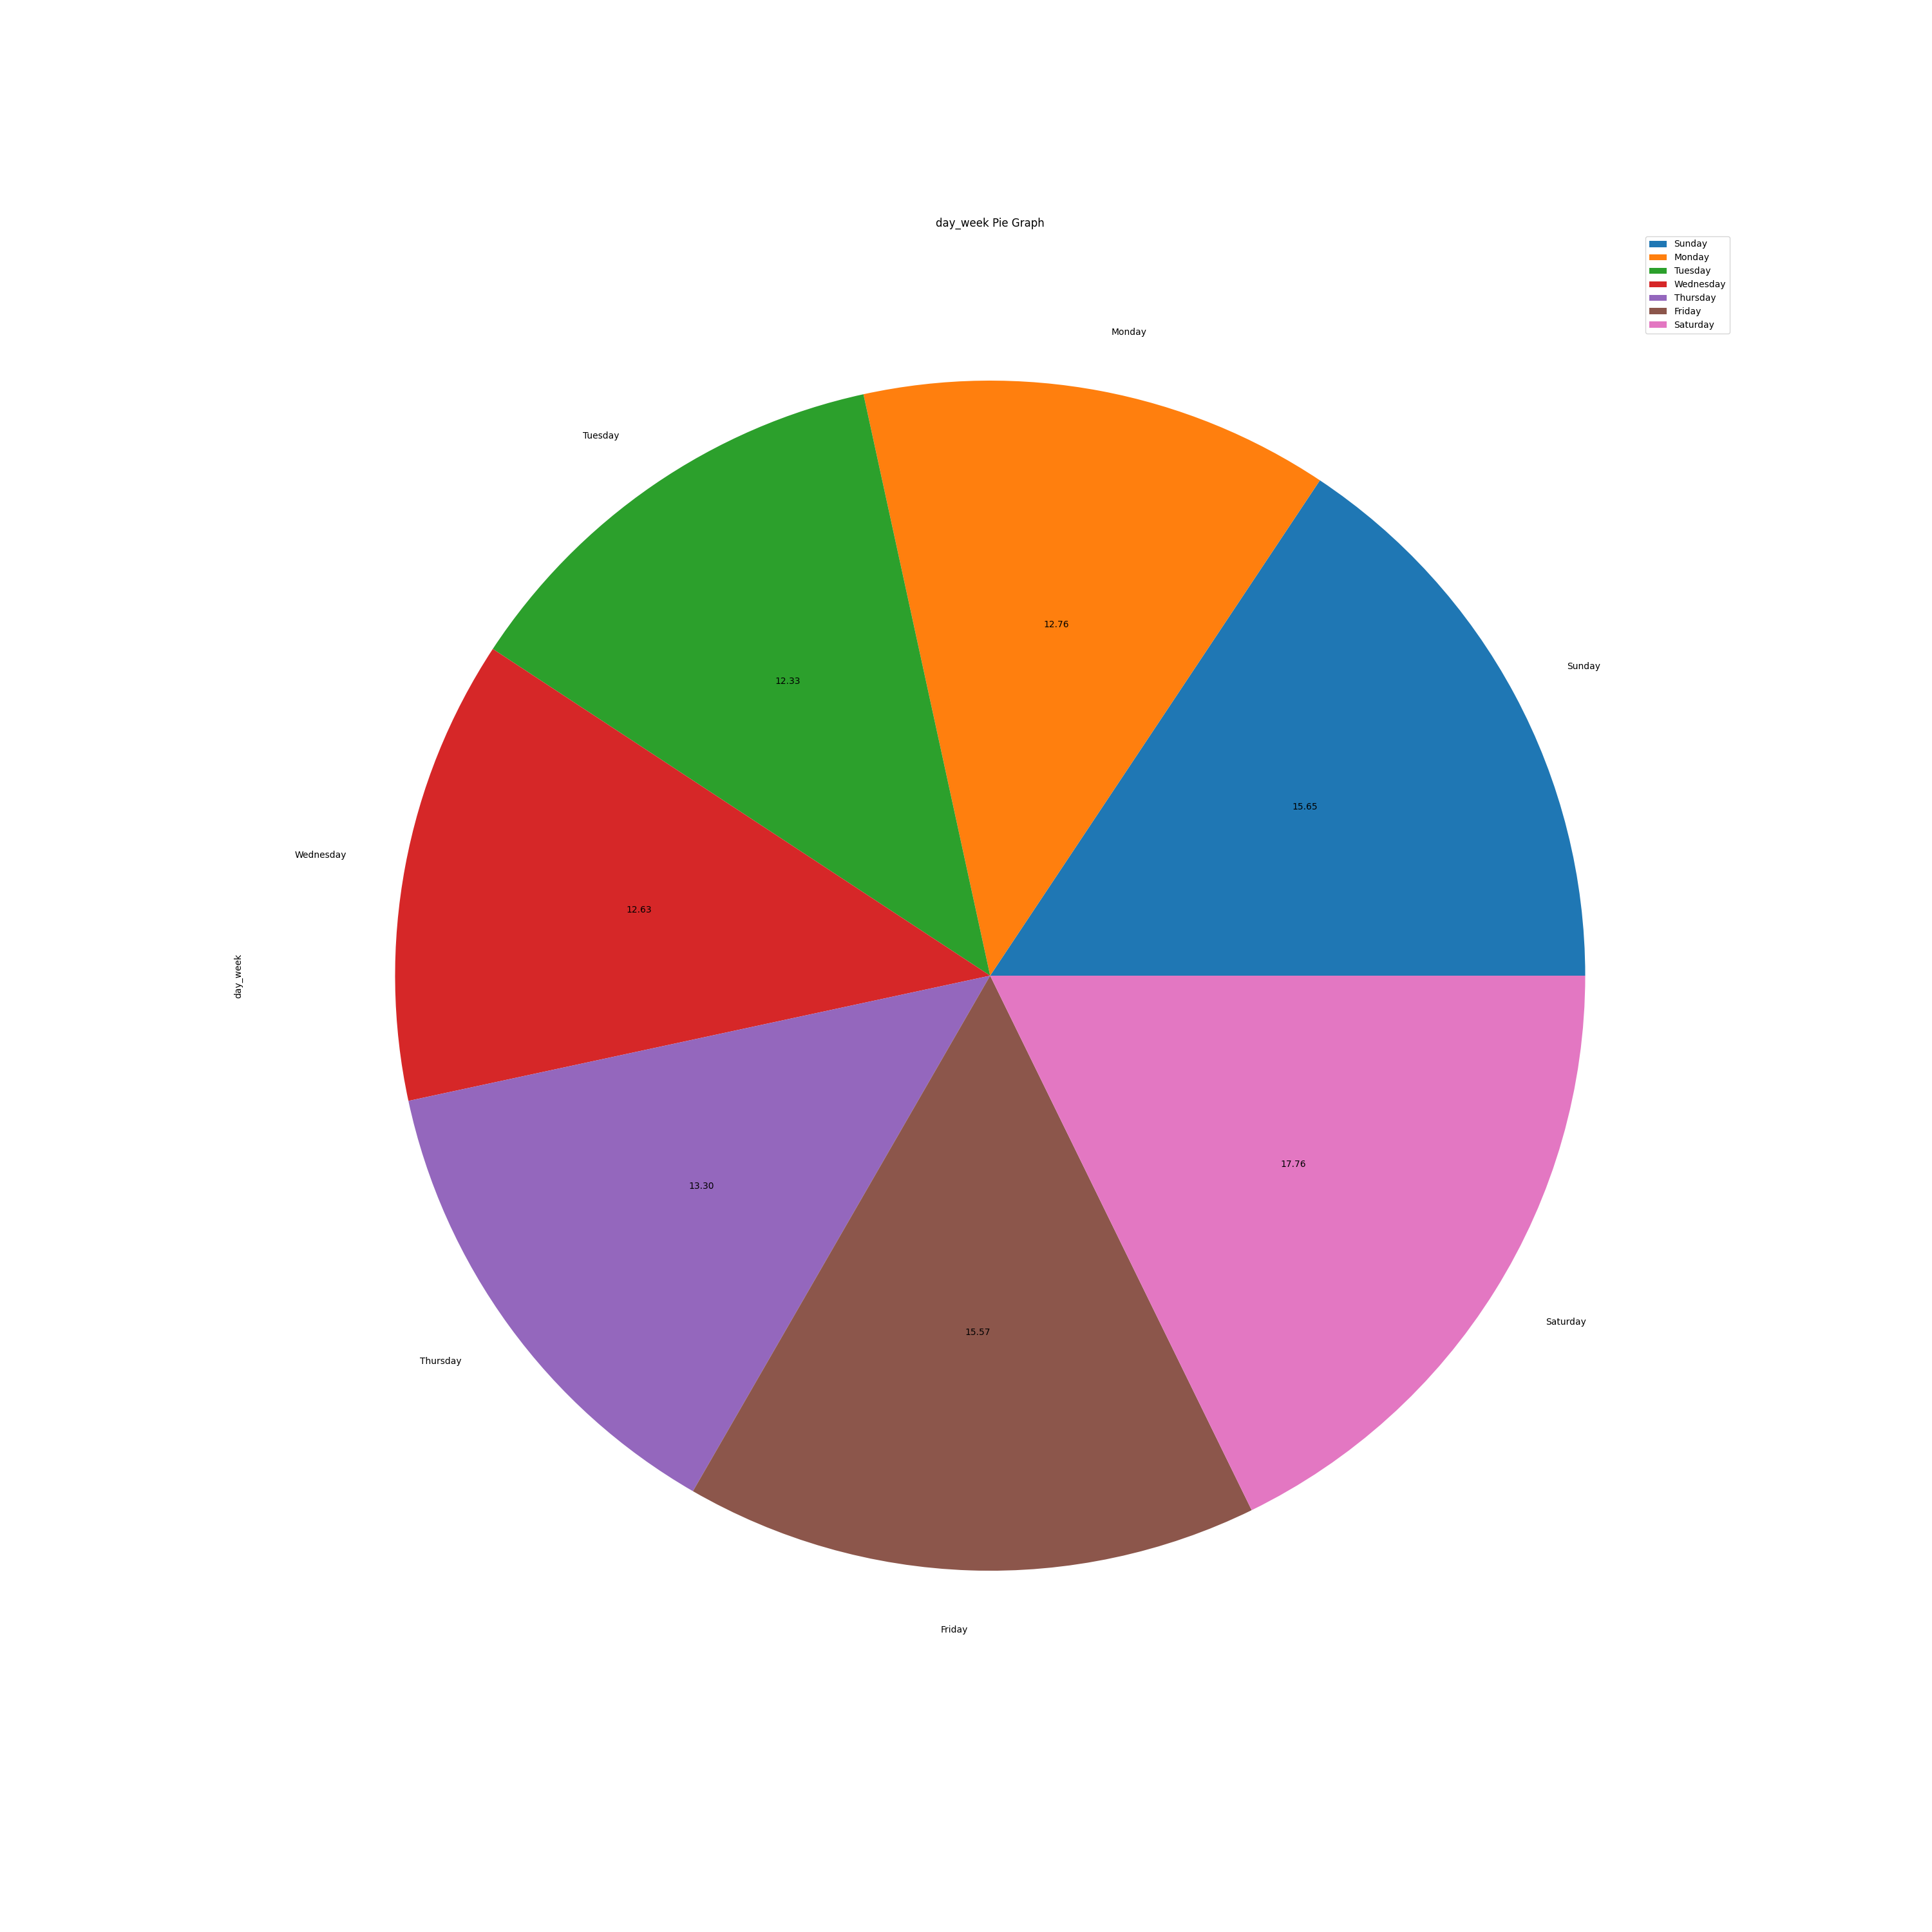
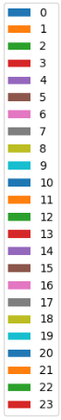
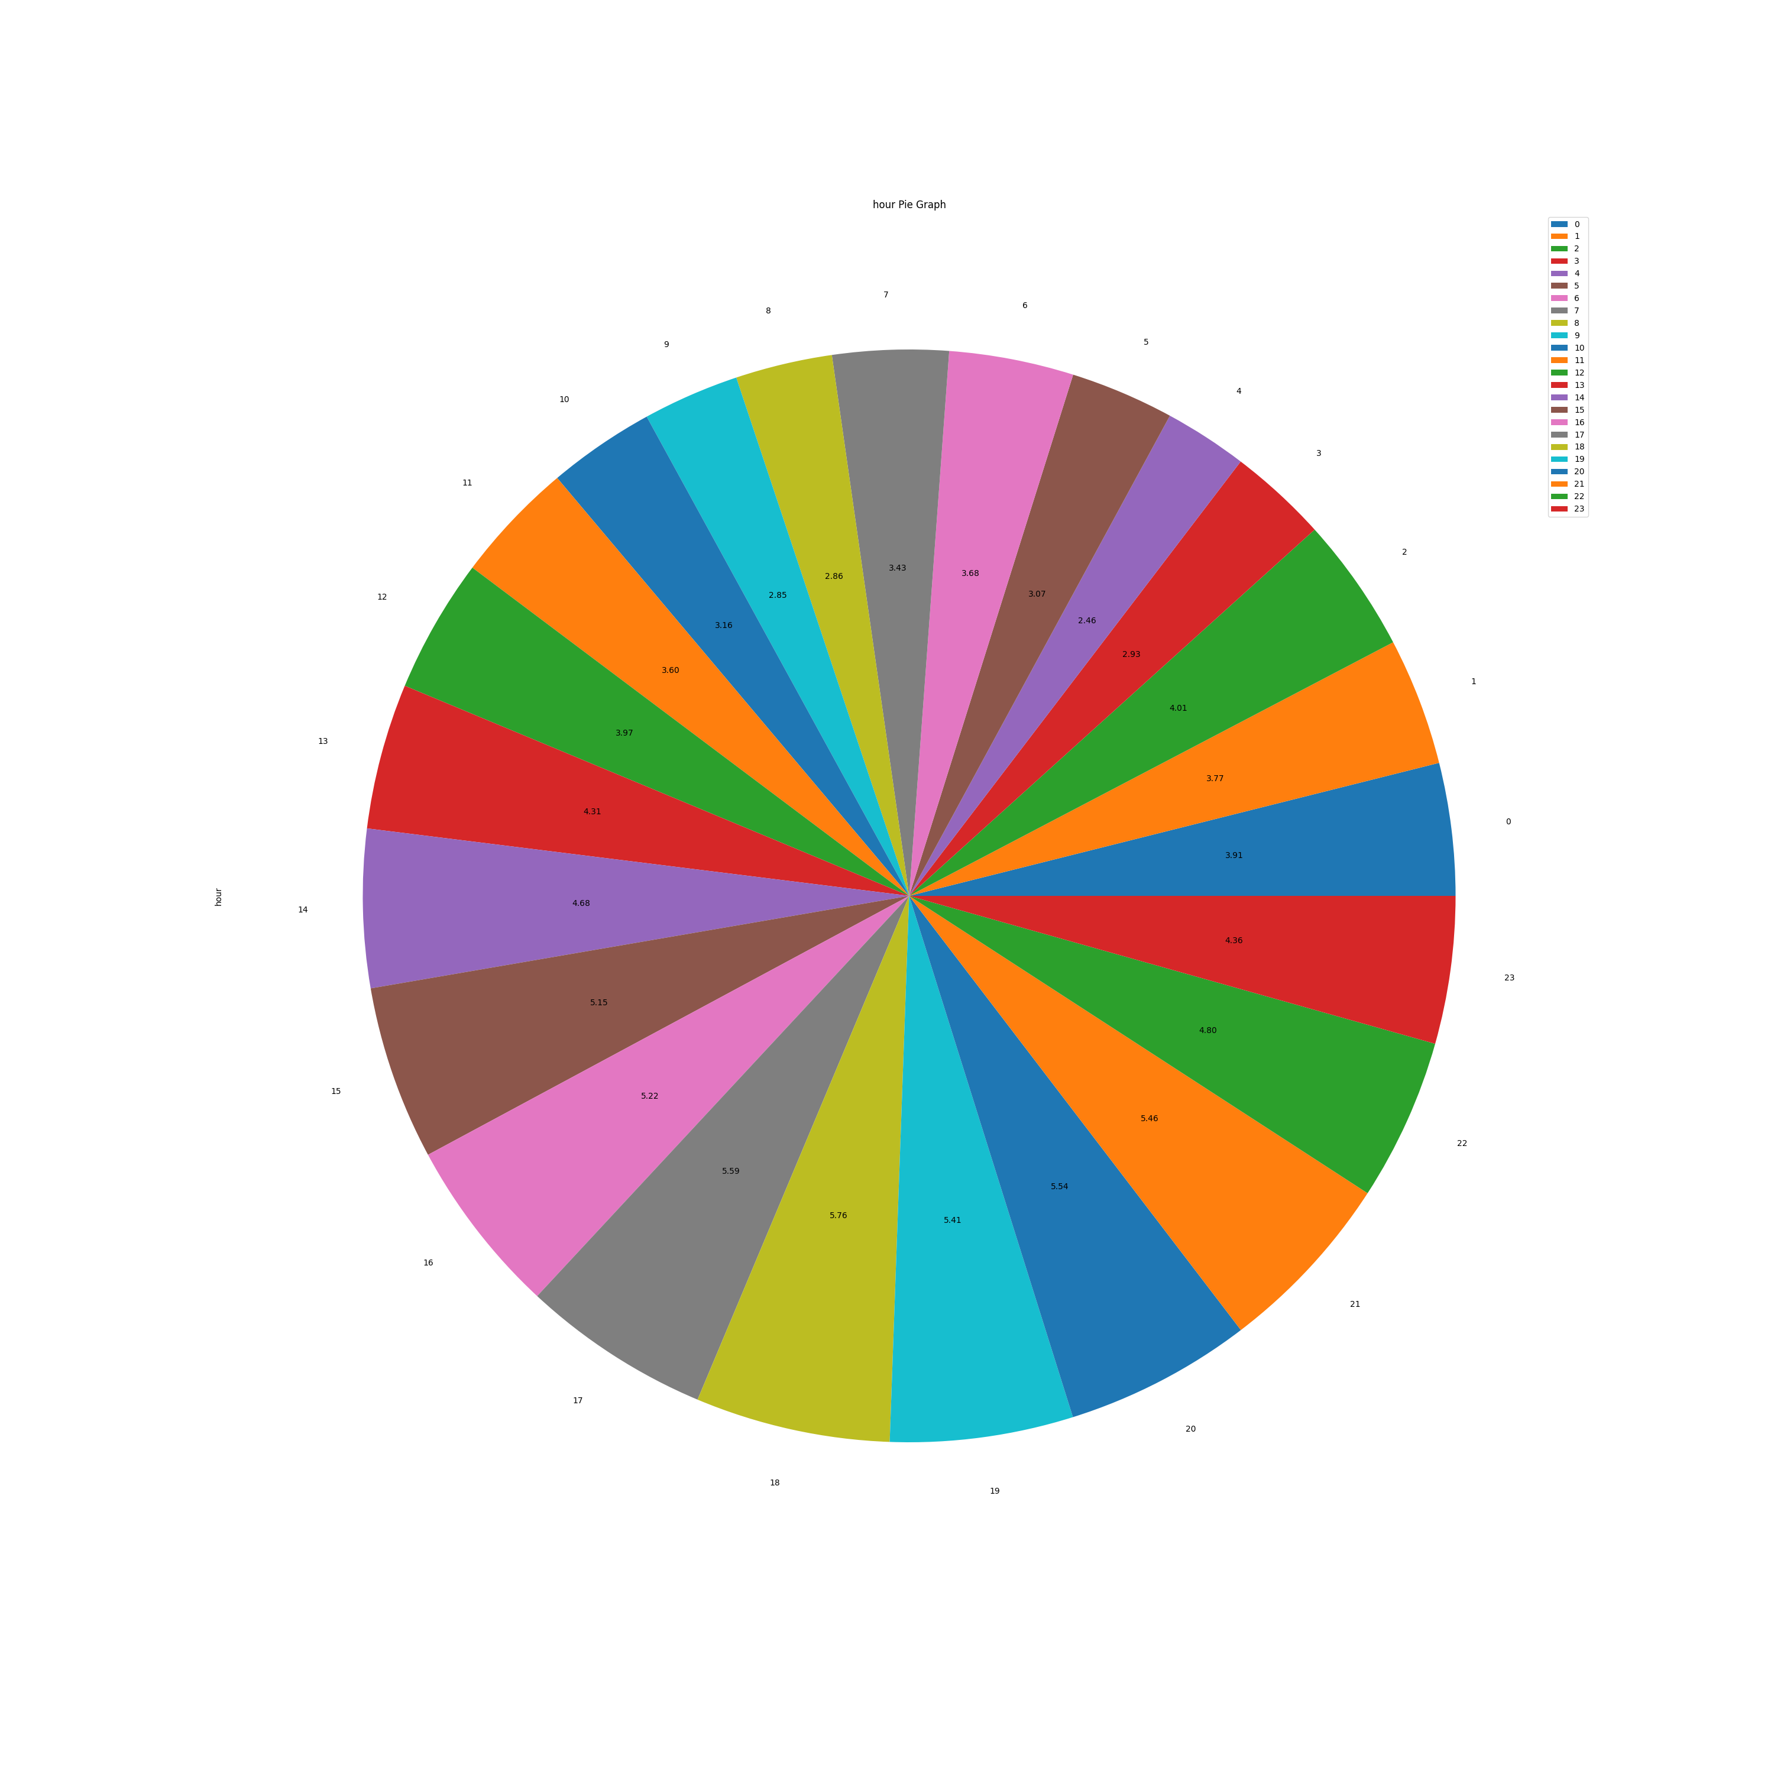
Graphs
Amount of Accidents Per Day:
Most accidents occur during the weekend (Friday Saturday and Sunday) - 48.98% of all accidents
Amount of Accidents Per Hour:
Most accidents occur between 17:00 to 19:00.

Slide 11
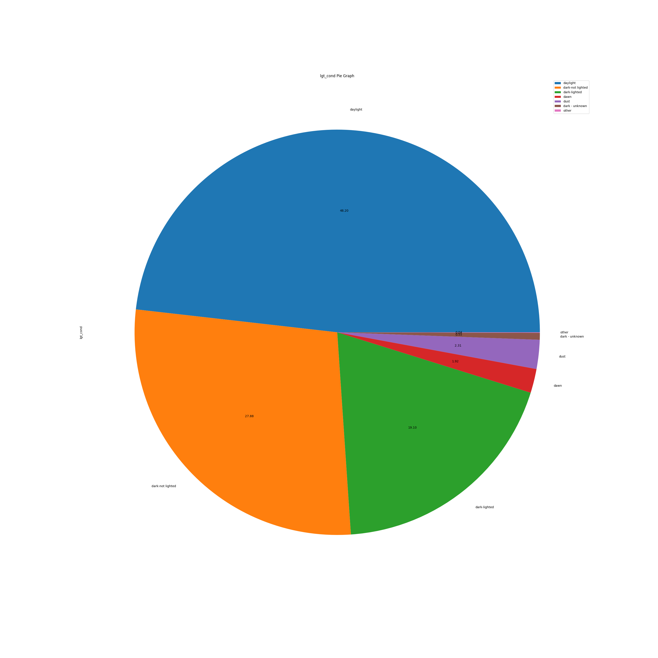
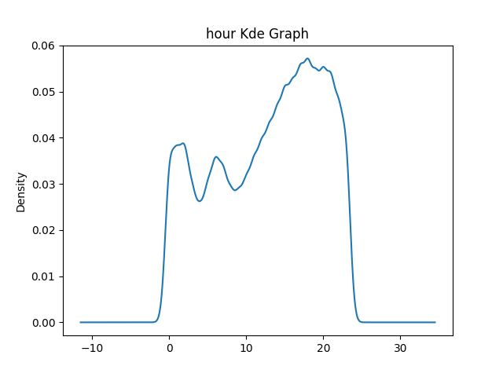
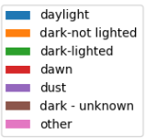
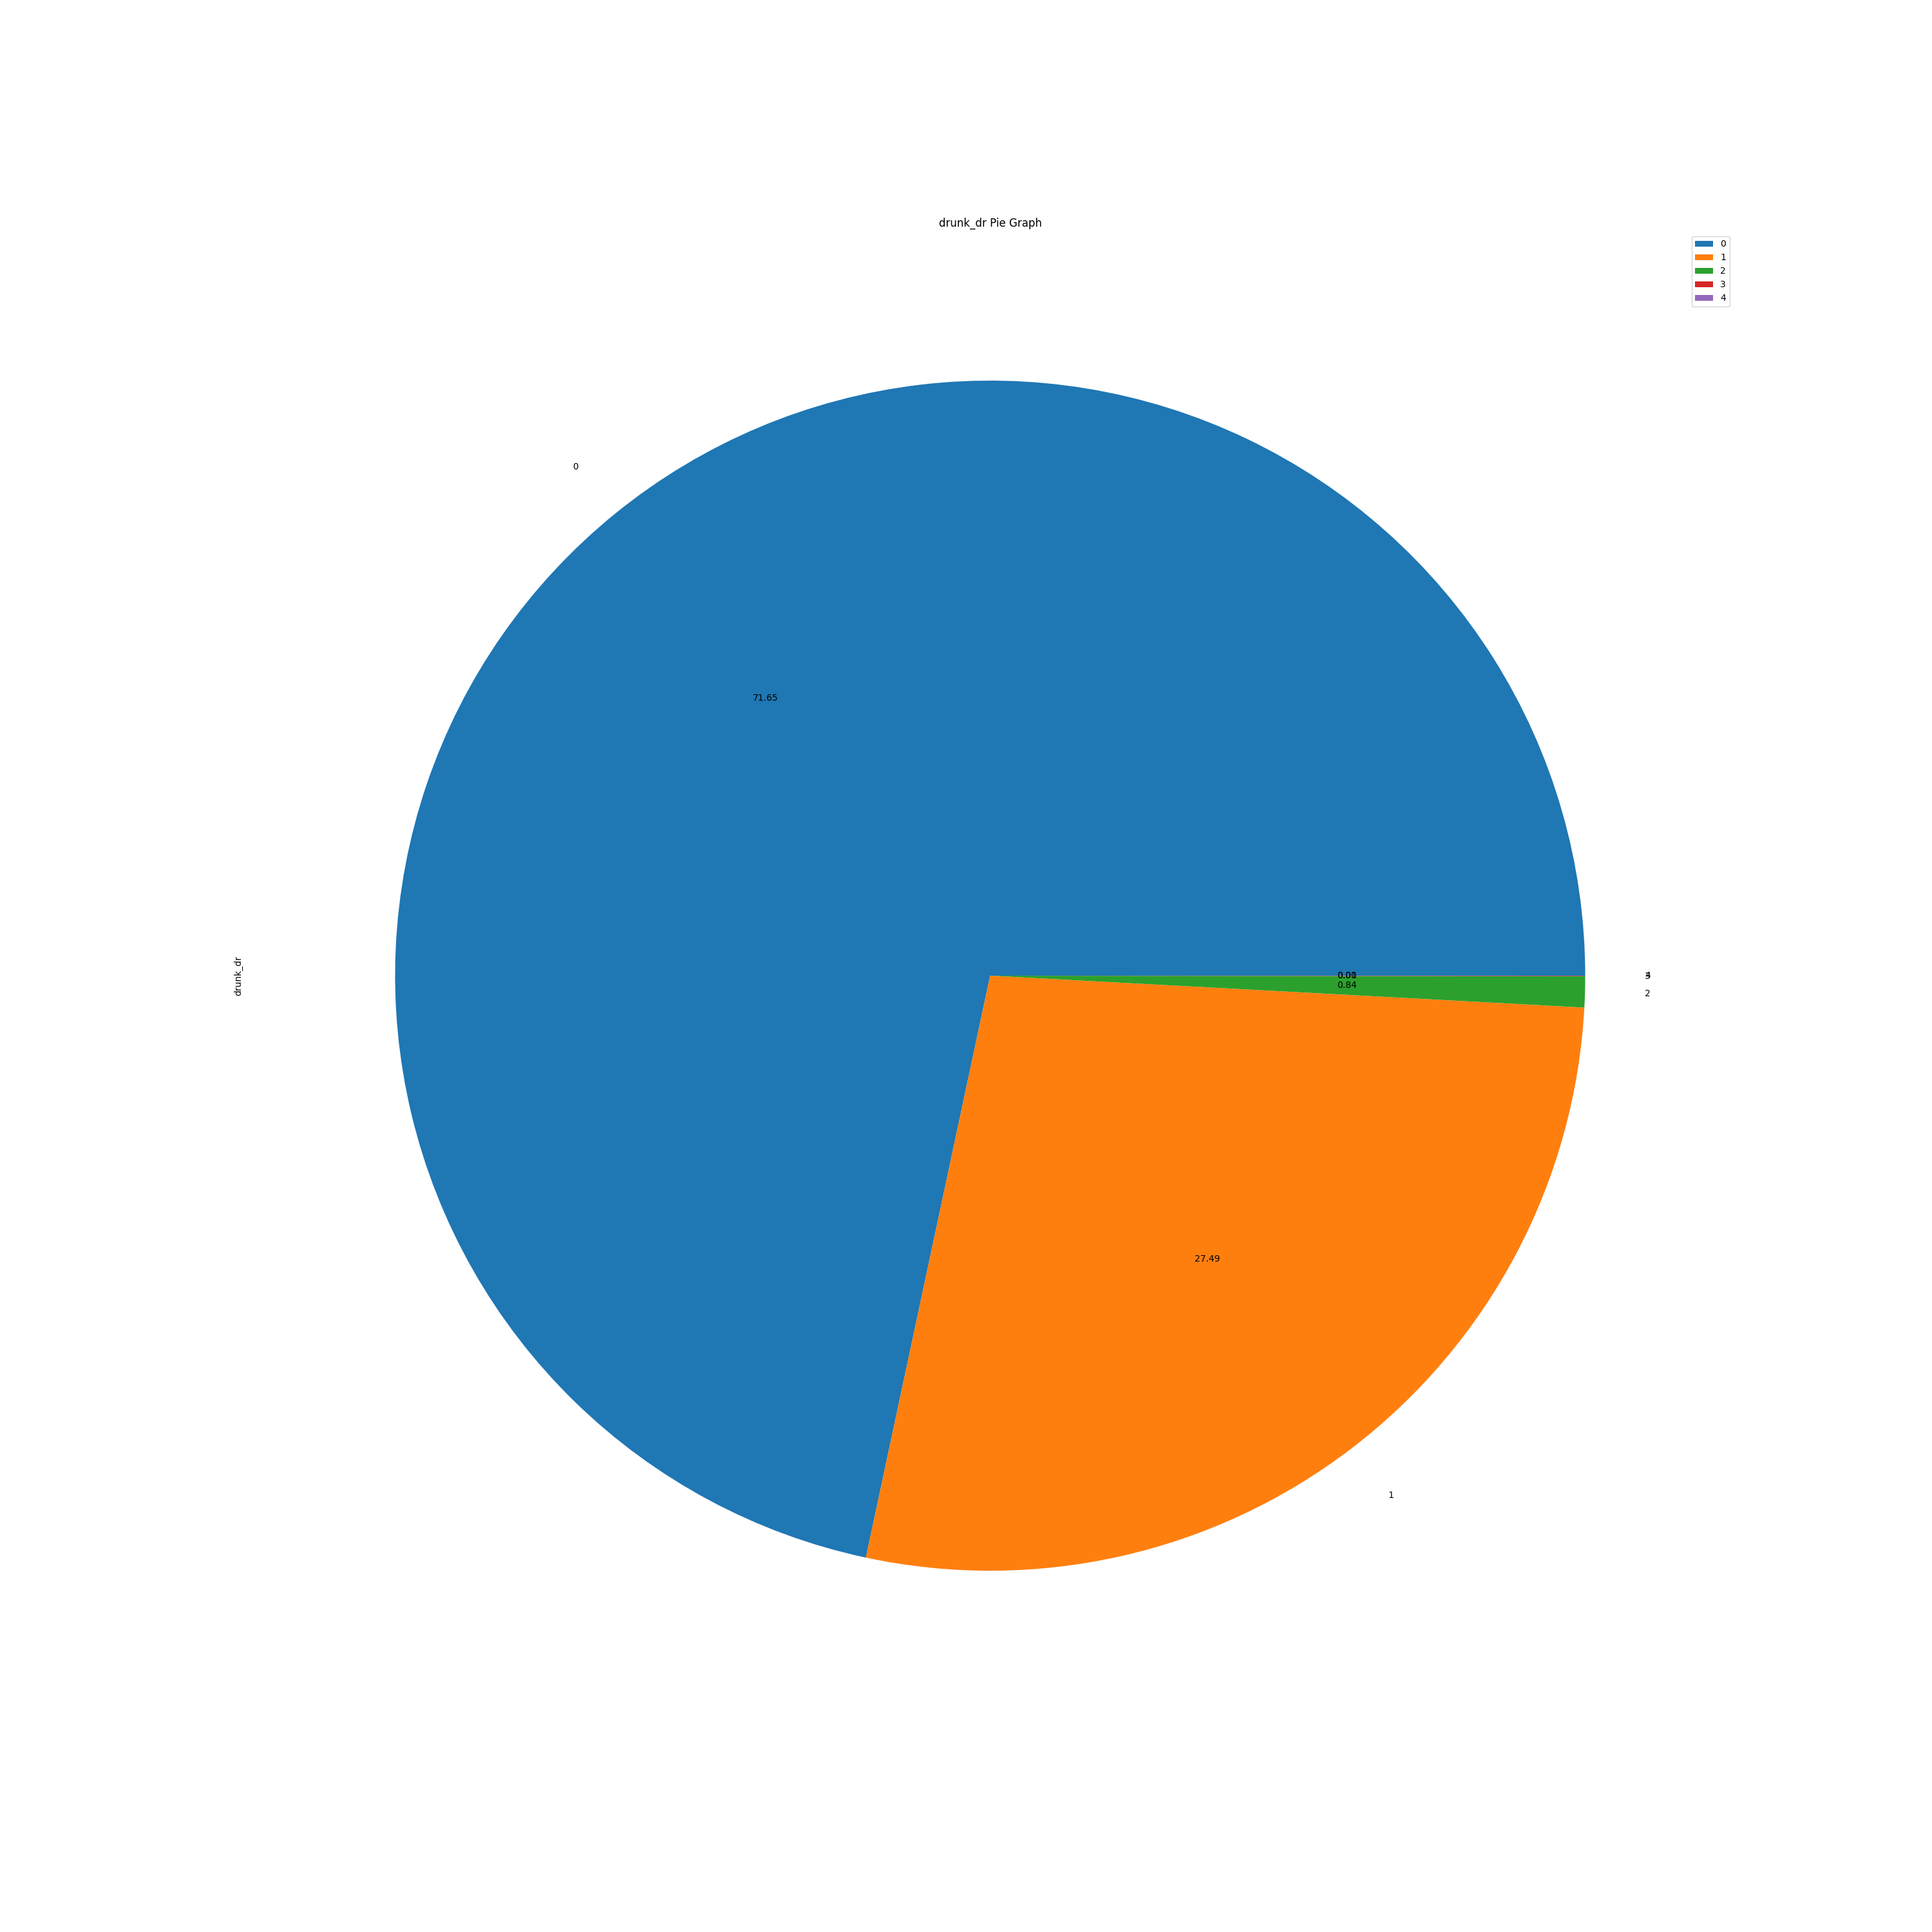
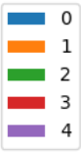
Graphs
Amount of Accidents – Light Conditions:
Most accidents occur during daylight - 48%
Amount of Accidents – Drunk Drivers Involved:
71% of Accidents – 0 Drunk drivers.
29% of Accidents involved at least 1 drunk driver.

Slide 12
Graphs
In the following scatter plot, we can see the USA map, generated according to the accidents longitude and latitude locations, from the database.

Slide 13
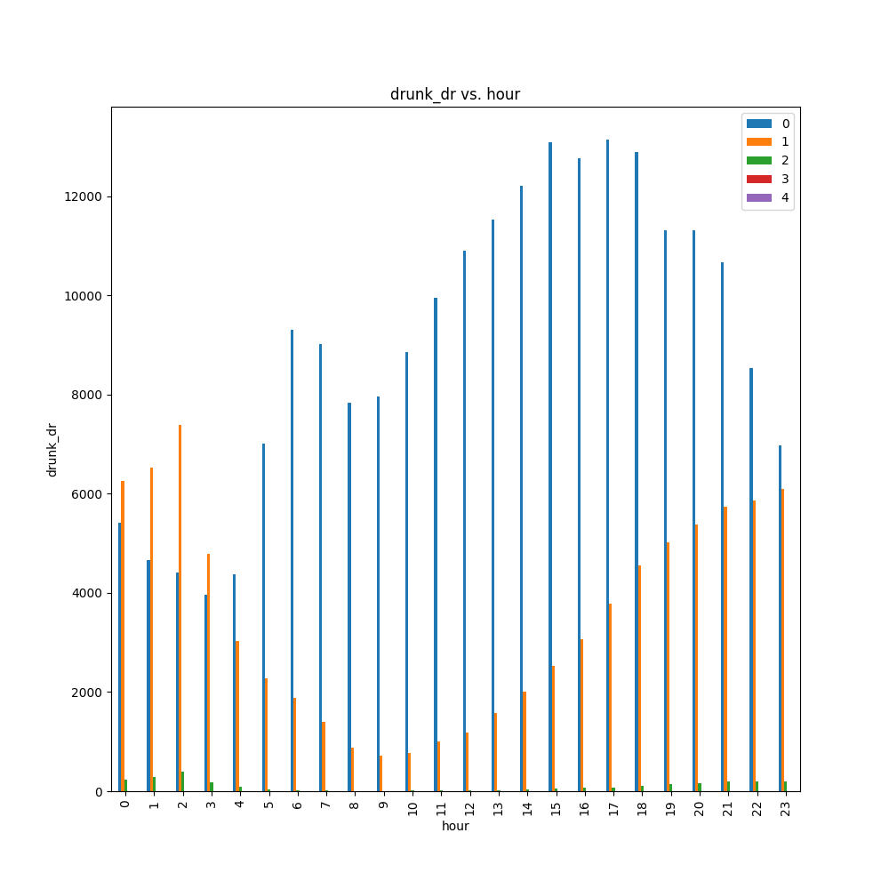
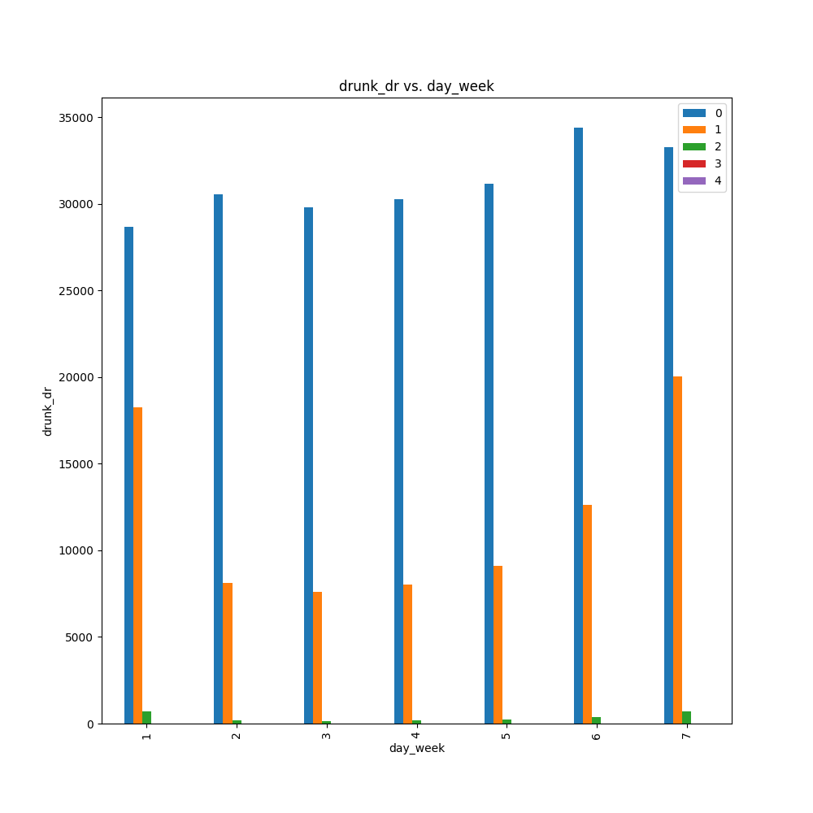
Graphs
Accidents with drunk drivers mostly occur at night, when the peak hour is 2 am.
At weekends, accidents involve more drunk drivers(Friday, Saturday and Sunday).

Slide 14
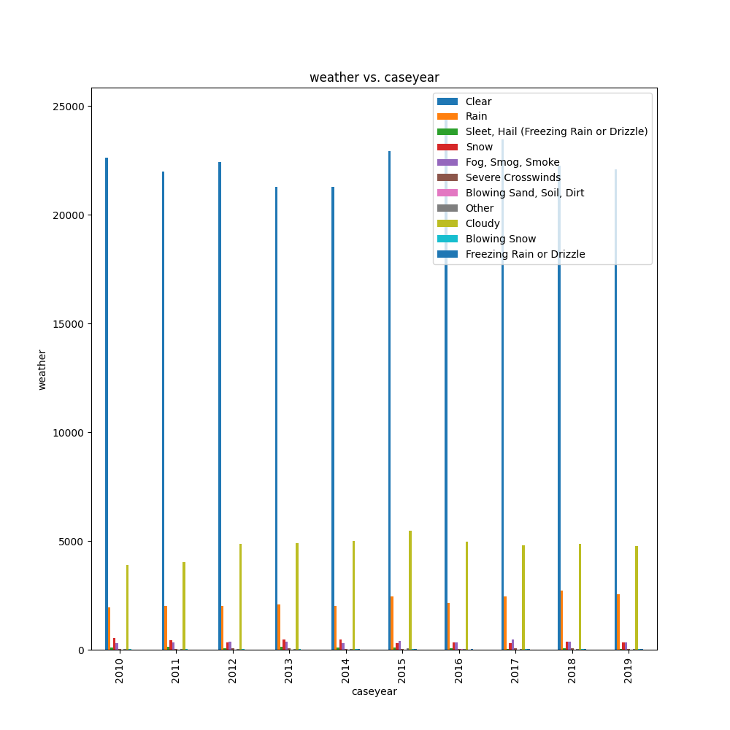
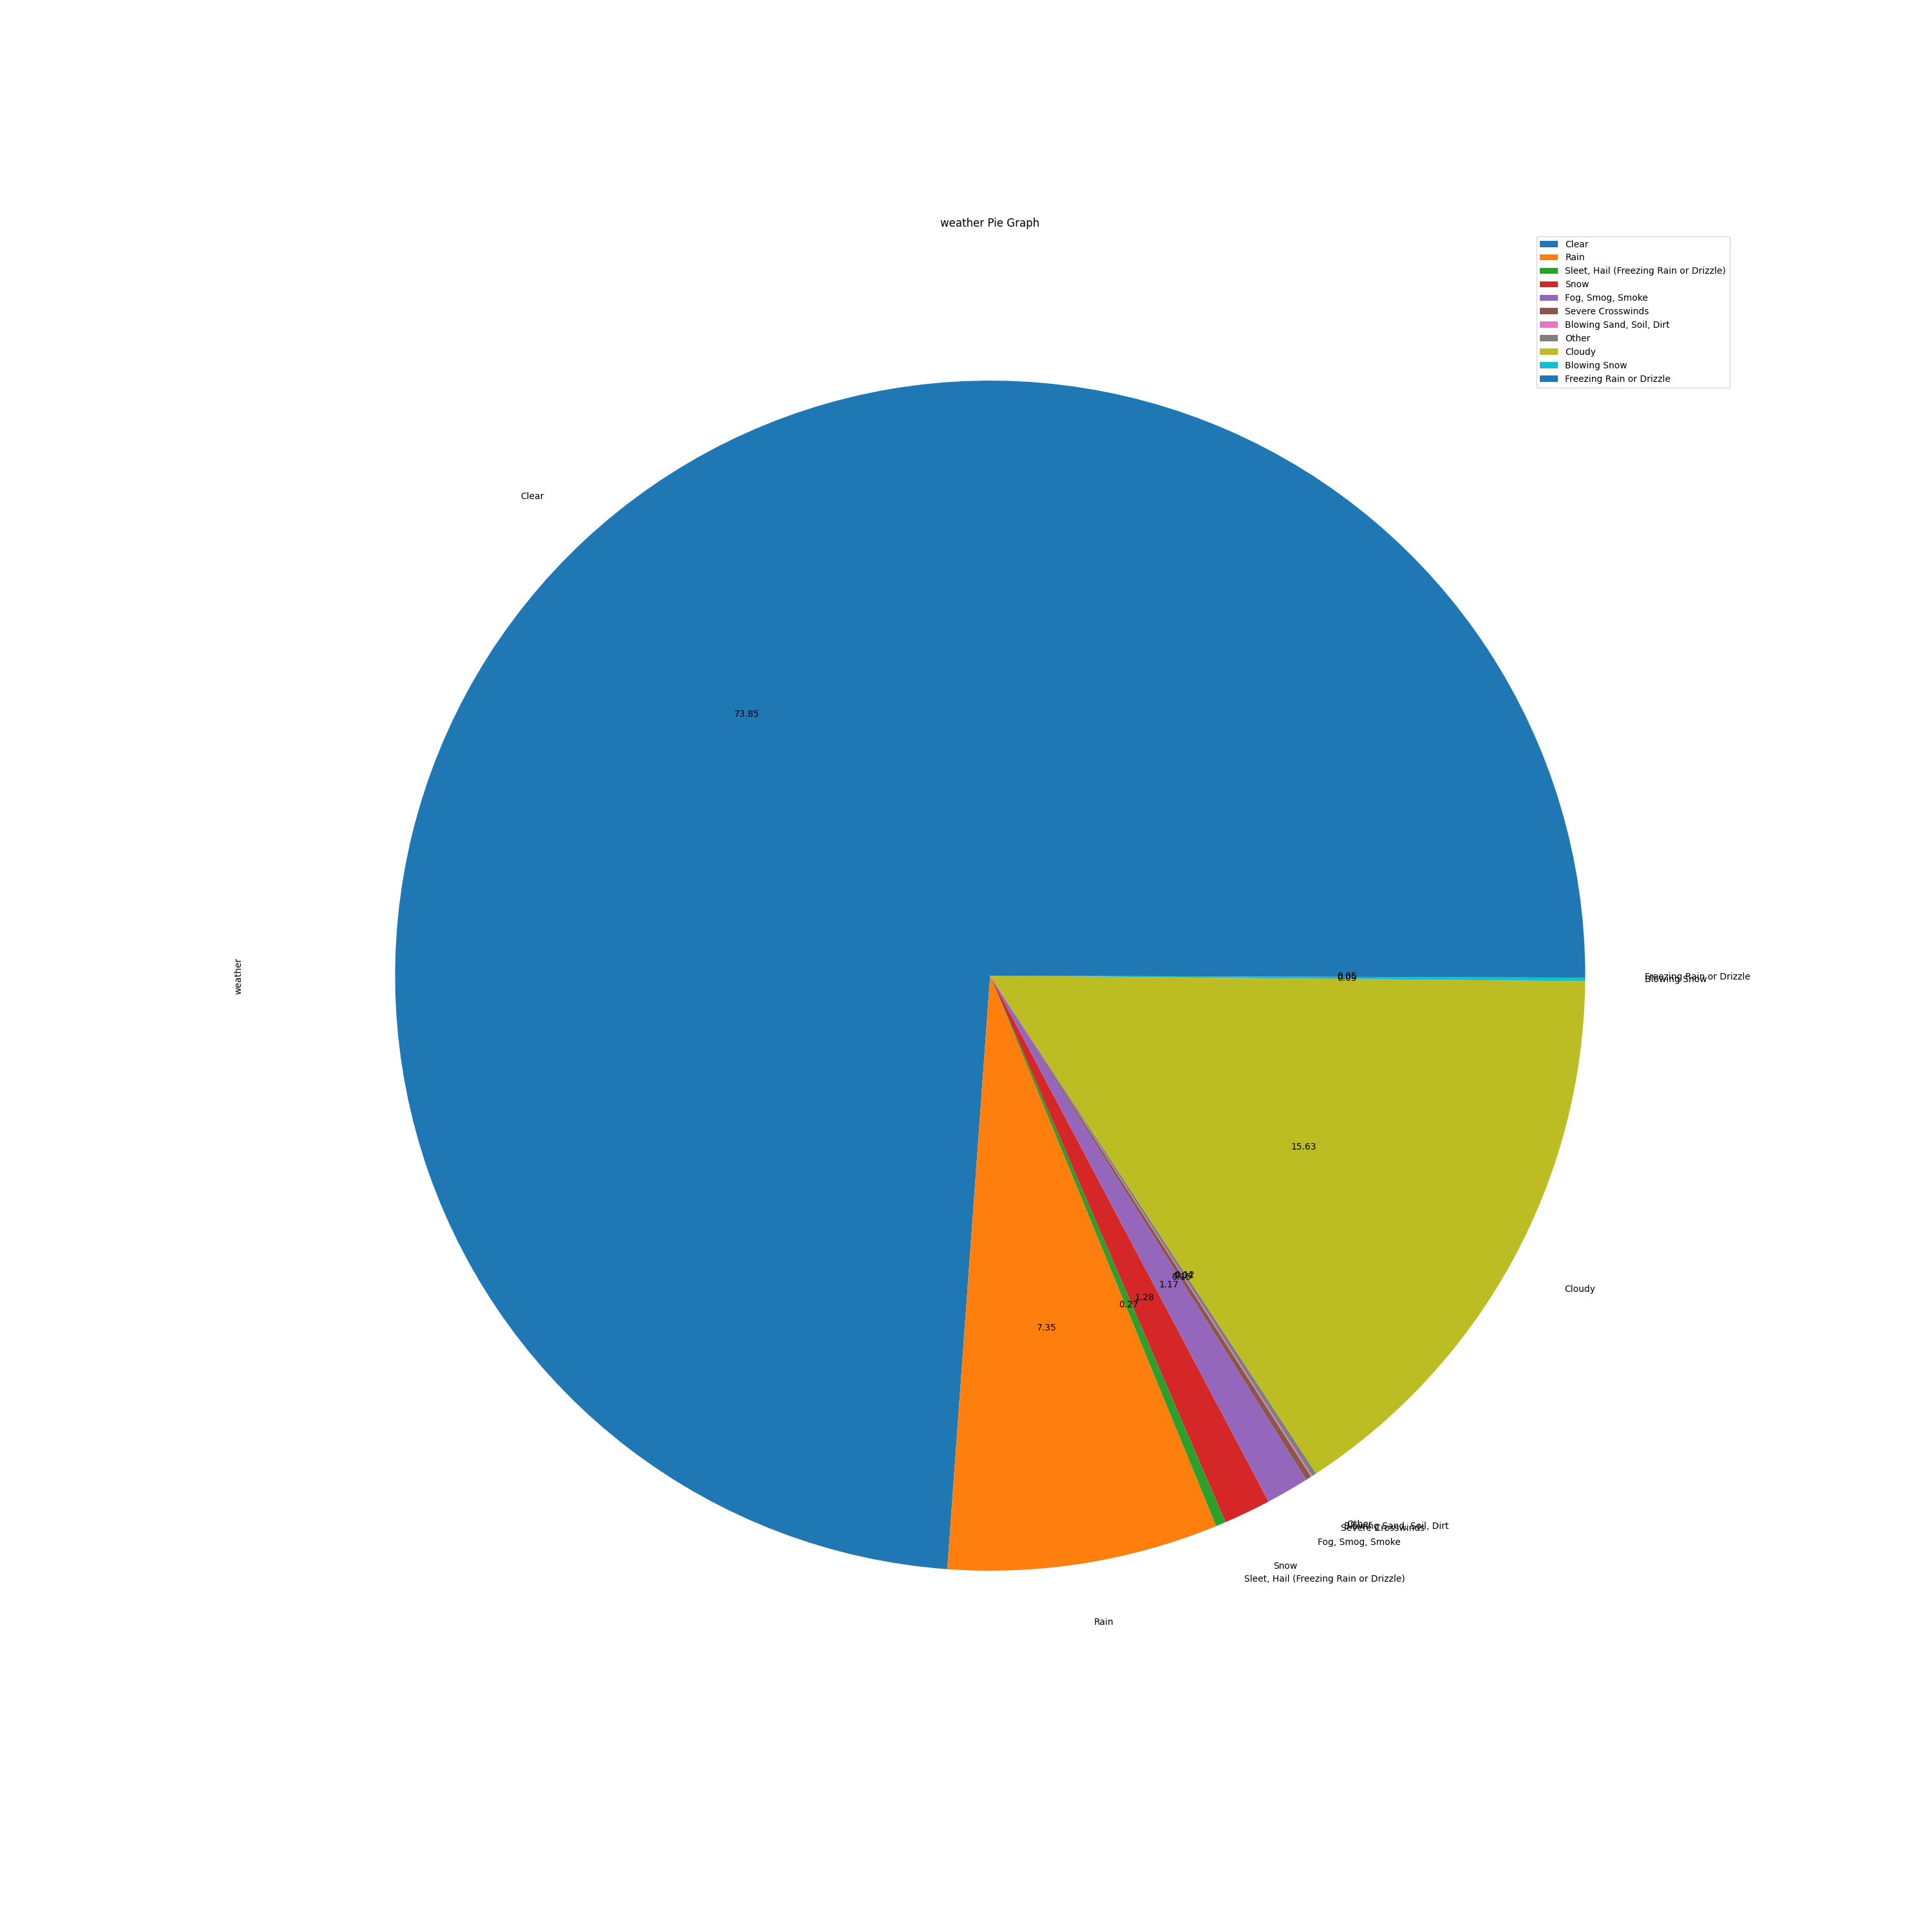
Graphs
Is there a connection between the amount of car accidents to the weather conditions occurred at the time of the accident?
As you can see from the data,
most of the accidents occur during clear weather.

Slide 15
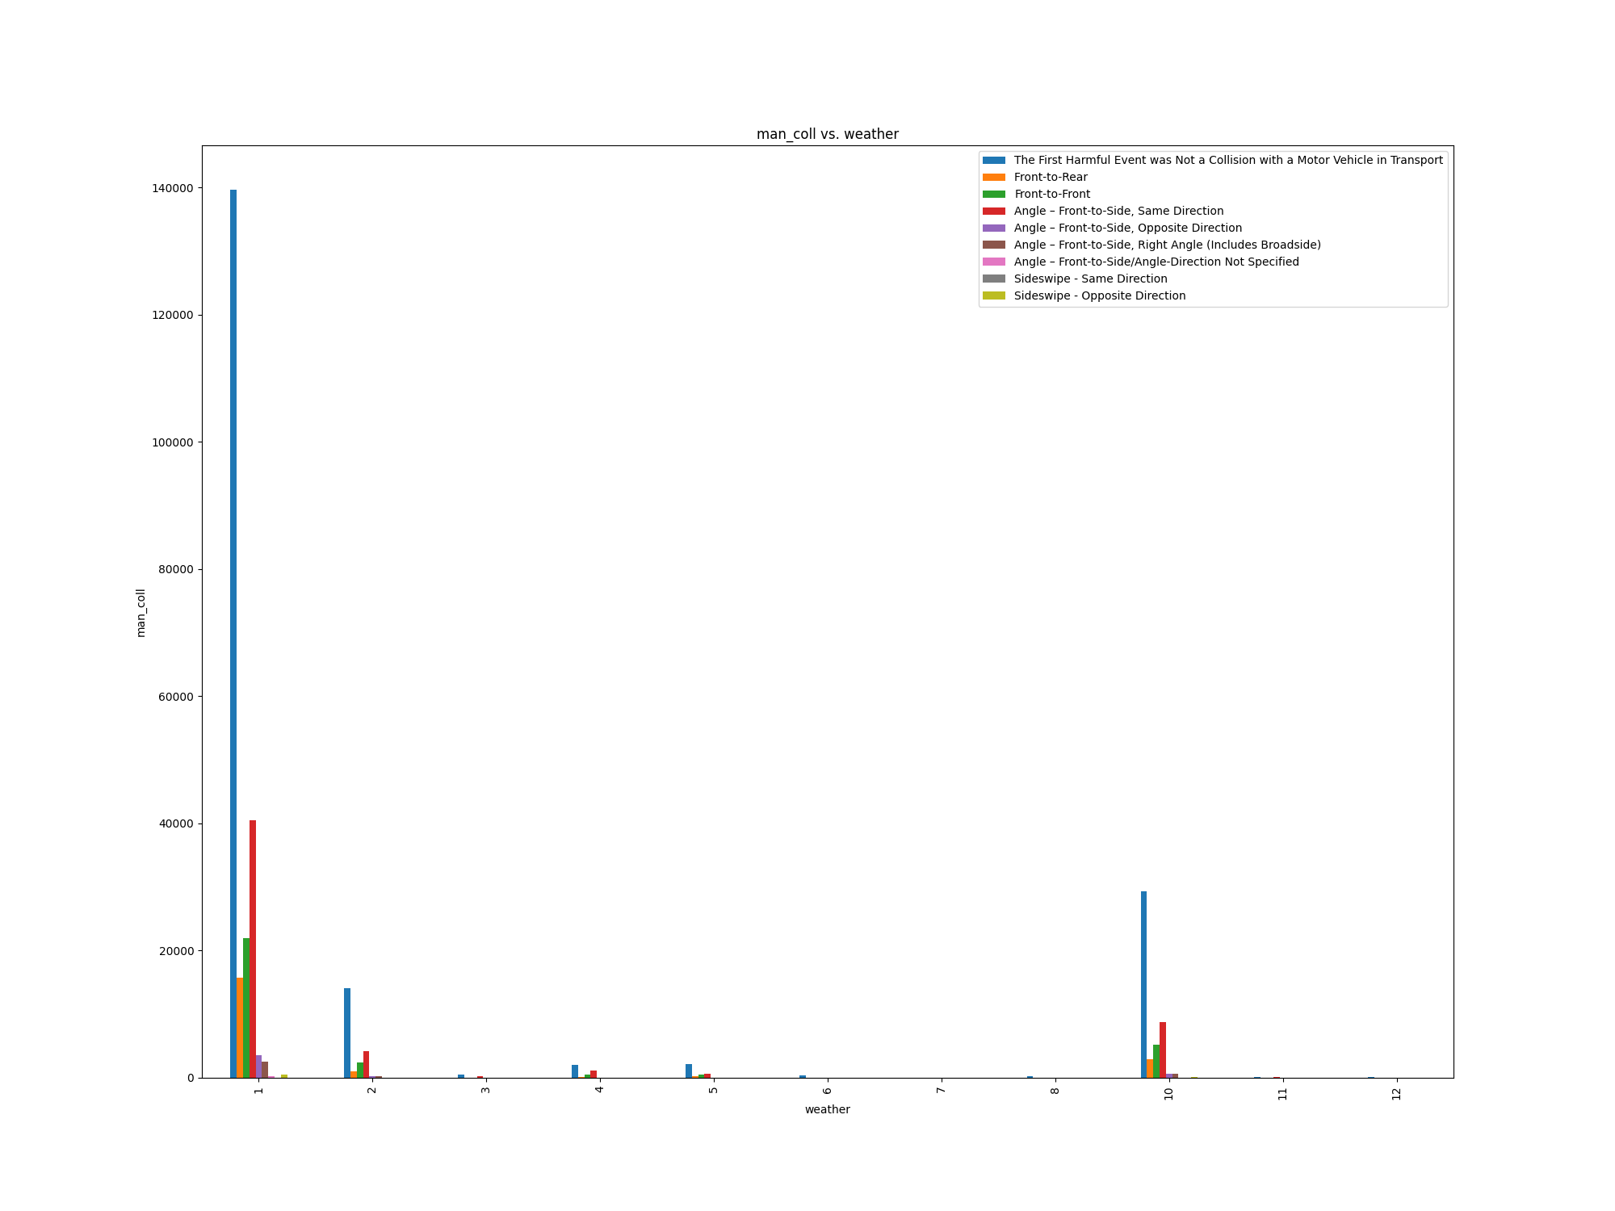
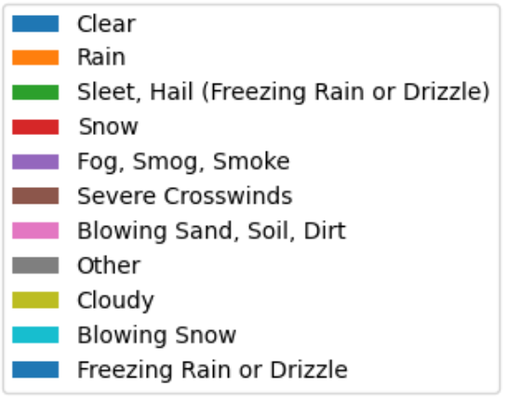
Graphs
Is there a connection between the weather and the type of accidents happened ?
About 50% of all accidents that occur during clear weather, not include collisions between another vehicle.
The second common type of accidents are angle collisions.
1
2
3
4
5
6
7
8
9
10
11
12

Slide 16
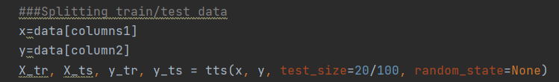
Machine Learning
As our data is mainly categorical, we decided to use and implement Decision Tree model as our Machine Learning and prediction.
Our code generates the decision tree and tests according to the following steps:
We split the data:
x will hold the columns which are parameters used for the prediction.
y holds the prediction we wanted to know.
Our data is being sent train_test_split function
X_tr and Y_tr are used by the model for training.
X_ts and Y_ts are used for testing.
We chose to set the test size to 20%, which means 80% will be used for training, and 20% for testing.

Slide 17
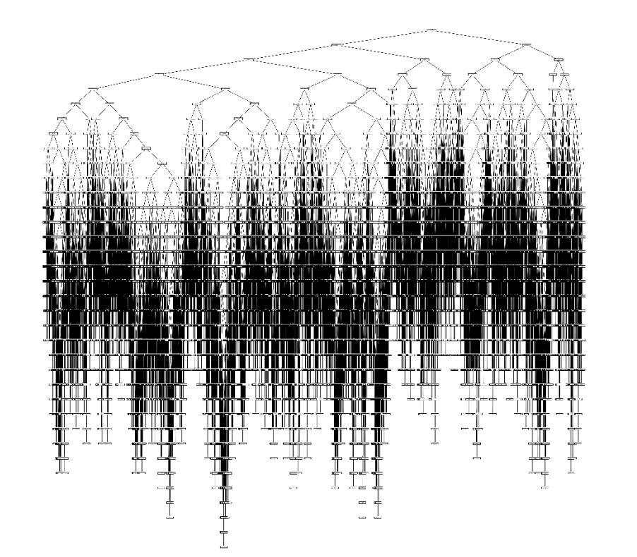
Machine Learning
Our code generates the Decision Tree as an output:
Here is an example of the decision tree our code generates for the following columns slicing:
Can your predict the fatality rate according to the following data: Day, Month, State, Weather and Light Conditions?
machine_learning.create_prediction(data, ['day','month', 'state', 'weather','lgt_cond'], 'fatals')
Click To Open File:

Slide 18
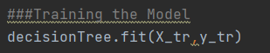
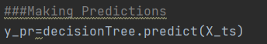
Machine Learning
In the following steps we use fit() to train our model, with X_tr and Y_tr.
We use predict() with 20% of the data (X_ts and Y_ts) to test the data:
As a result of our requested prediction: [Day, Month, State, Weather and Light Conditions] against [Fatality], we got the following results:

Slide 19
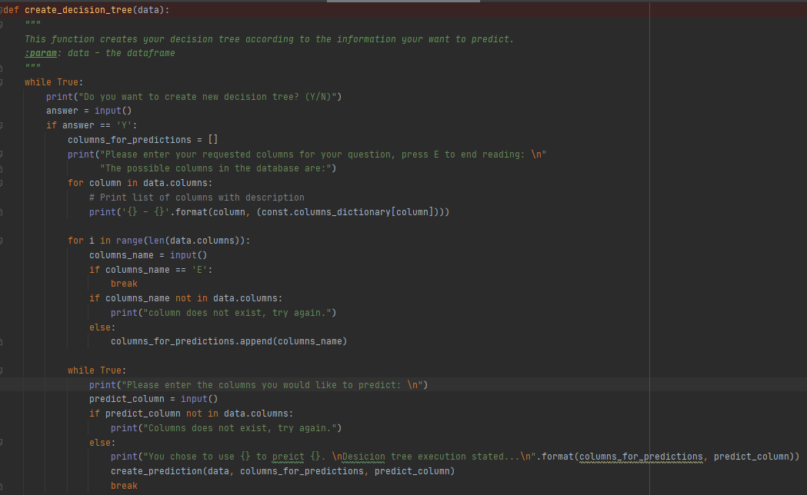
Machine Learning
We added auto prediction function to create and predict different inputs of columns:

Slide 20
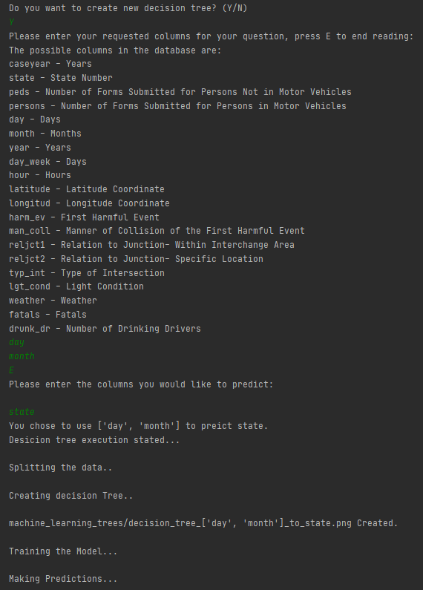
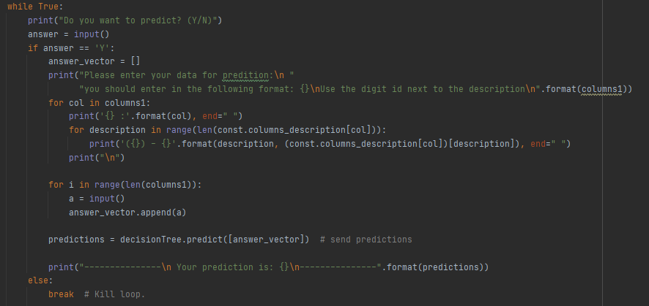
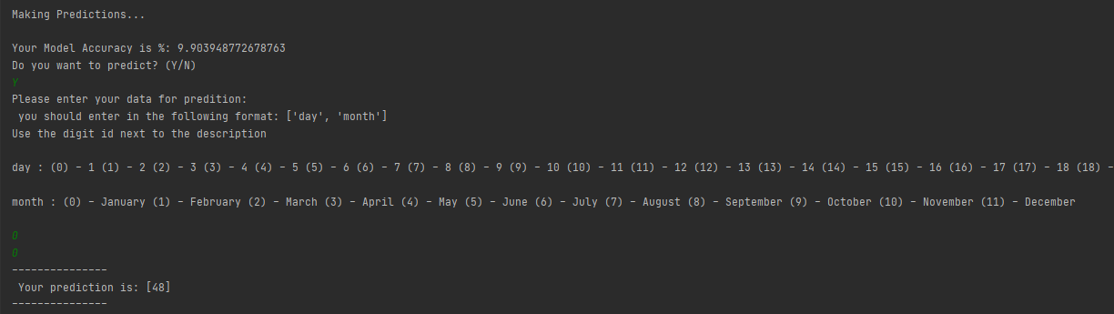
Machine Learning
We added auto prediction option to test different inputs of data:

Slide 21
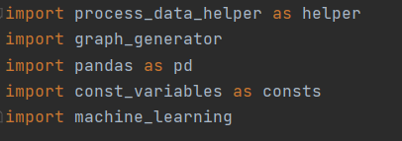
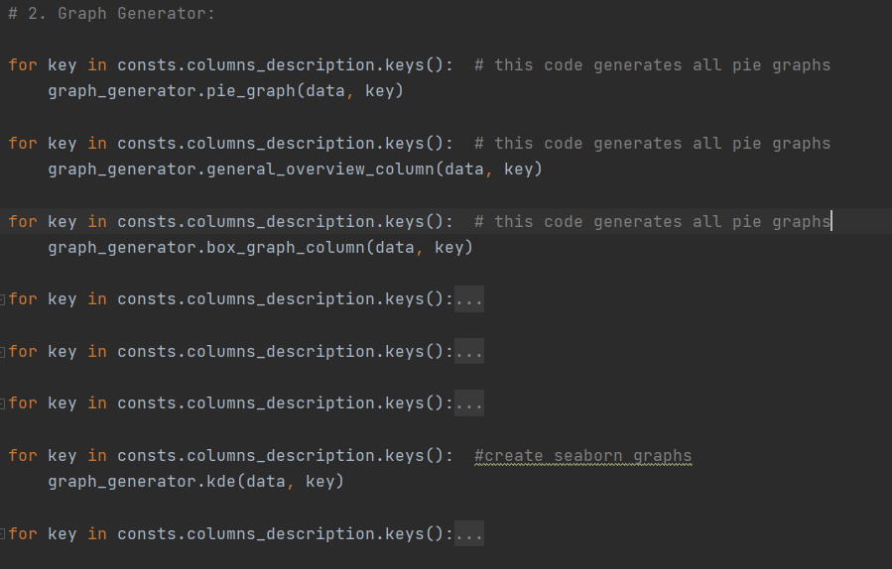
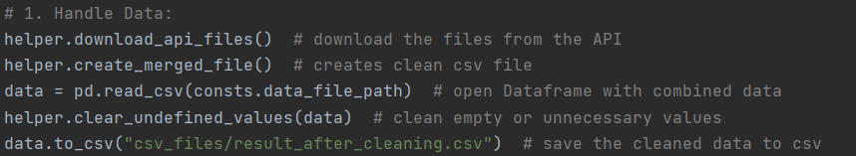
Code Explanations and Project Structure
main.py
Imports:
Generating Graphs According to Data:
Getting, Handling and Cleaning the Data:
Executing AI Machine Learning Process:

Slide 22
Code Explanations and Project Structure
The project uses Following files:
main.py – Hold the main code that runs and uses the below python files.
const_variables.py – Holds constant variables, lists and dictionary’s for various parameters in our data, we defined the variables using “Fatality Analysis Reporting System (FARS) Analytical User’s Manual, 1975-2019.PDF”.
graph_generator.py – Handles all function for different graph generation
machine_learning.py – Holds Code for Machine Learning AI Section
process_data_helper.py – Holds Function for data cleaning and Data Merging.

Slide 23


